Slide 1
Epidemiological study for Prince George’s County
By: Eddie and Xander

Slide 2
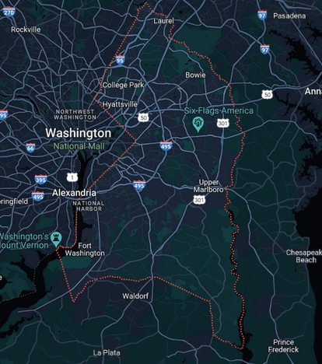
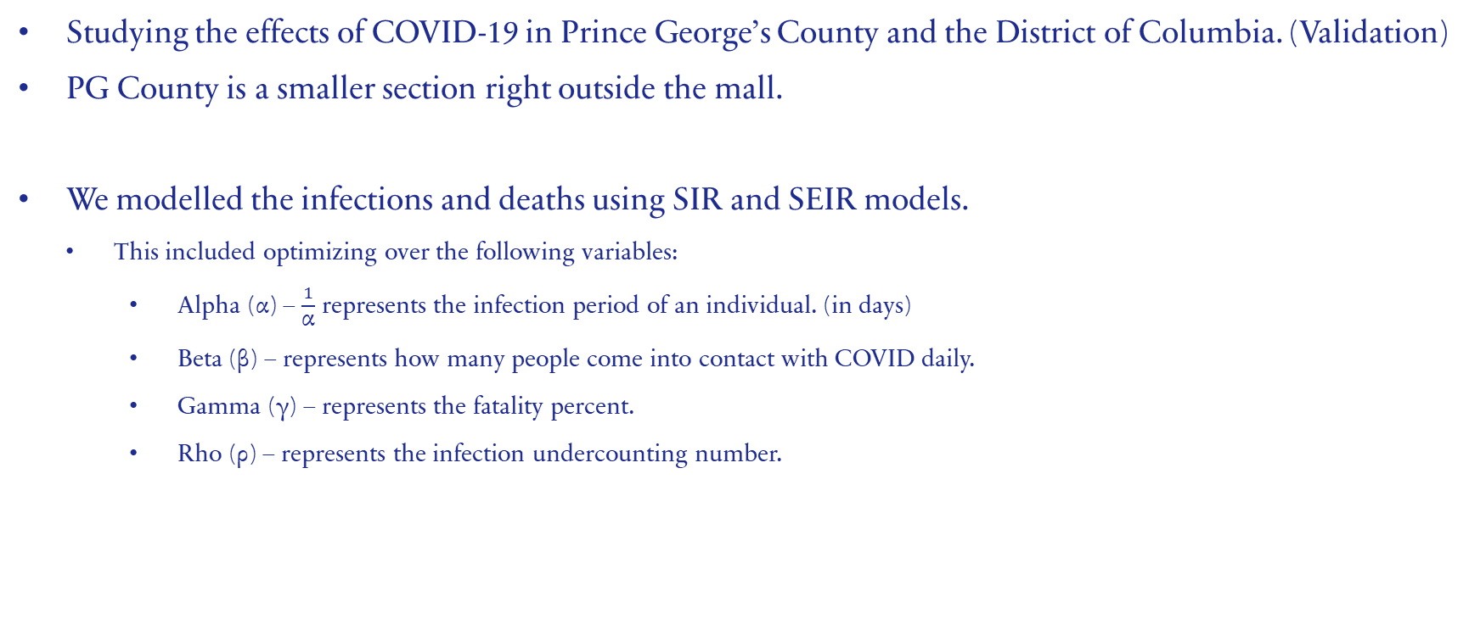
Description
Studying the effects of COVID-19 in Prince George’s County and the District of Columbia. (Validation)
PG County is a smaller section right outside the mall.
We modelled the infections and deaths using SIR and SEIR models.
This included optimizing over the following variables:
Alpha (α) – $\frac{1}{\text{α}}$ represents the infection period of an individual. (in days)
Beta (β) – represents how many people come into contact with COVID daily.
Gamma (γ) – represents the fatality percent.
Rho (ρ) – represents the infection undercounting number.

Slide 3
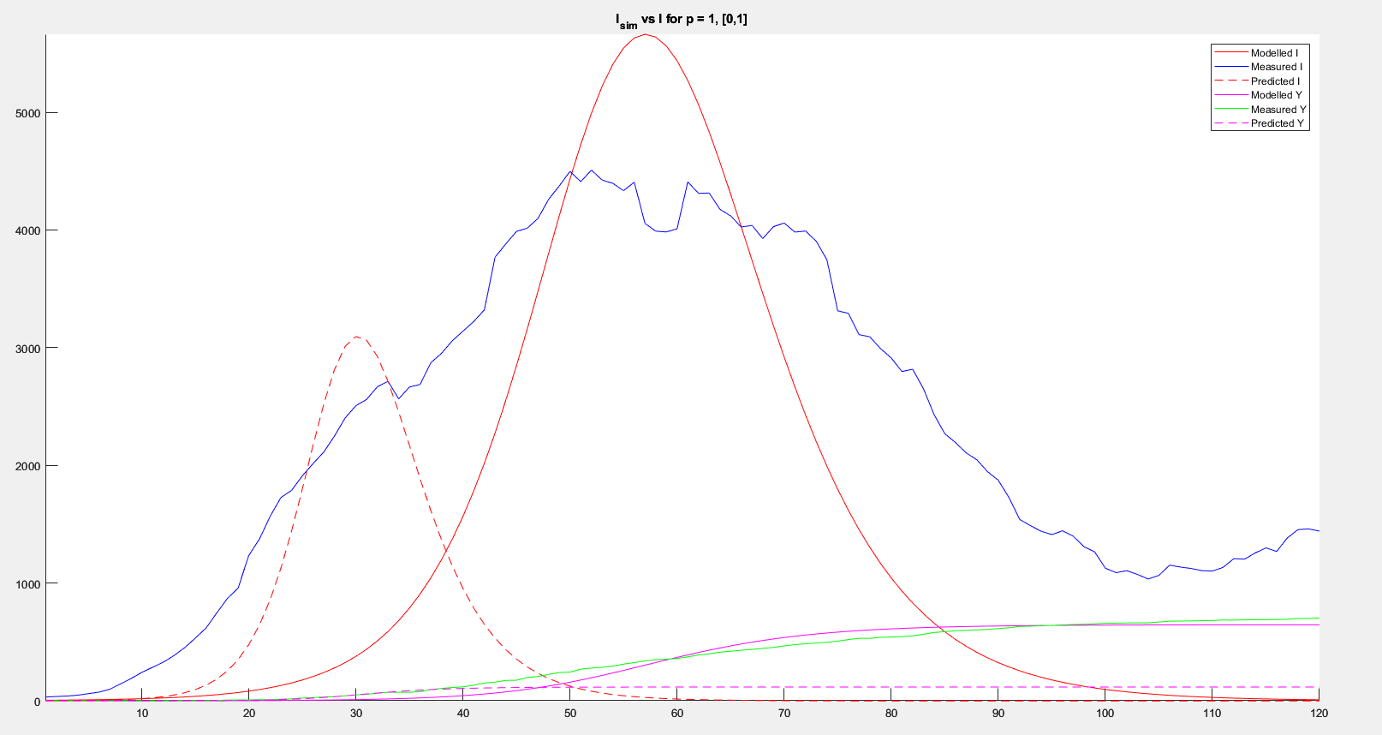
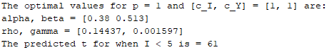
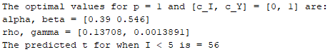
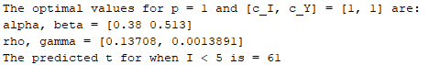
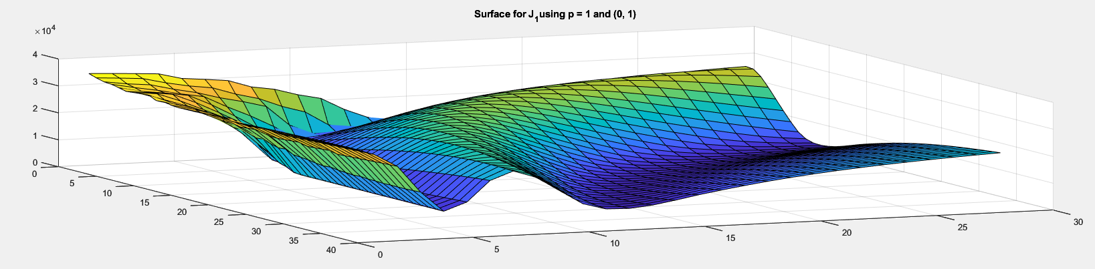
SIR Results (p = 1)
Optimal J value: 4661.26
[c_{I}, c_{Y}] = [0, 1]
α – 0.39
β – 0.546
R₀ – 0.71
ρ – 0.13708
γ – 0.0013891 (!)

Slide 5
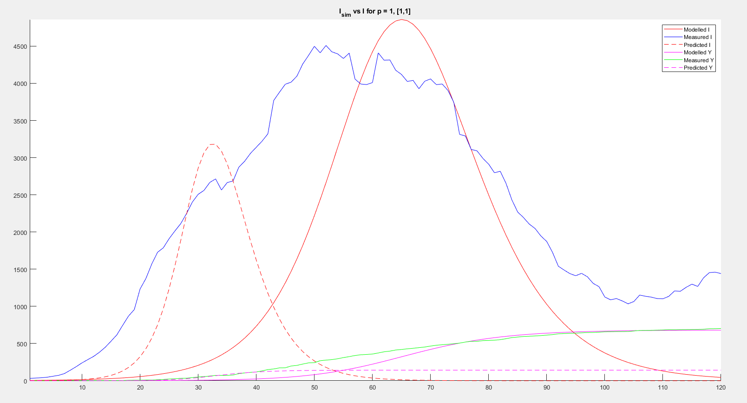
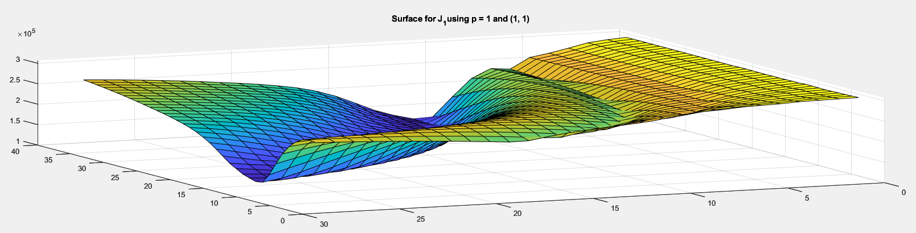
SIR Results (p = 1)
Optimal J value: 132302.20
[c_{I}, c_{Y}] = [1, 1]
α – 0.38
β – 0.513
R₀ – 0.74
ρ – 0.14437
γ – 0.001597 (!)

Slide 7
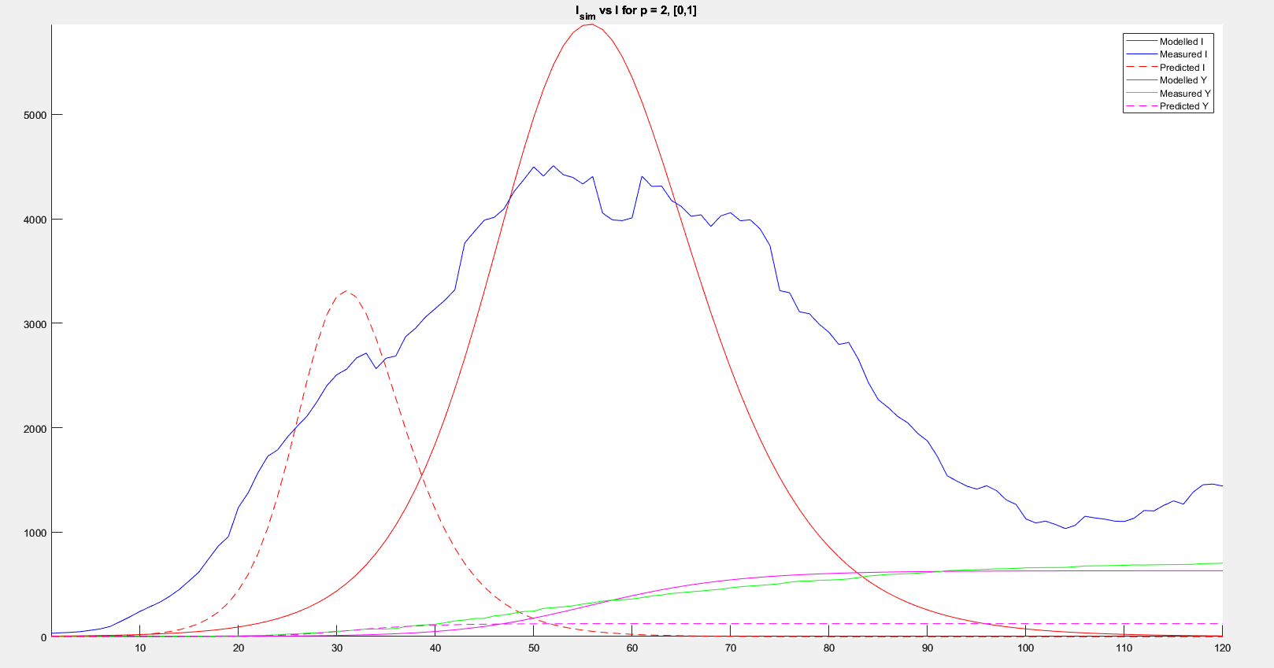
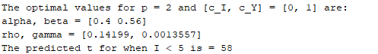
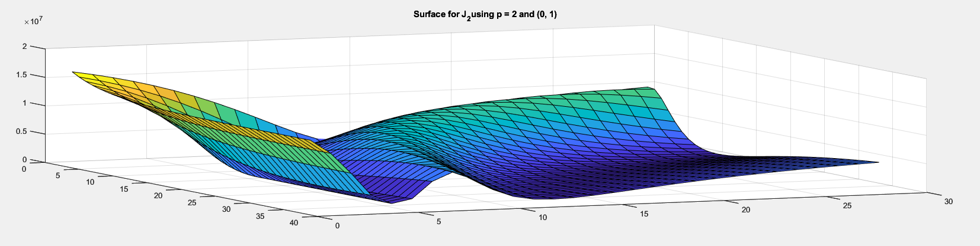
SIR Results (p = 2)
Optimal J value: 281747.38
[c_{I}, c_{Y}] = [0, 1]
α – 0.4
β – 0.56
R₀ – 0.71
ρ – 0.14199
γ – 0.0013557 (!)

Slide 8
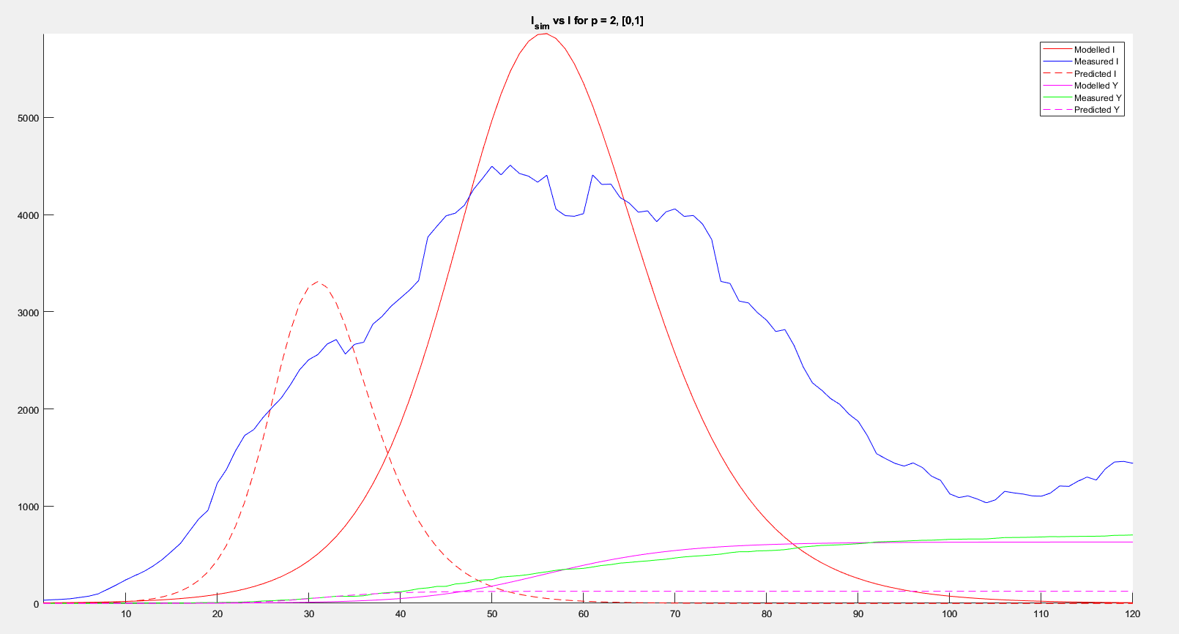

Slide 9
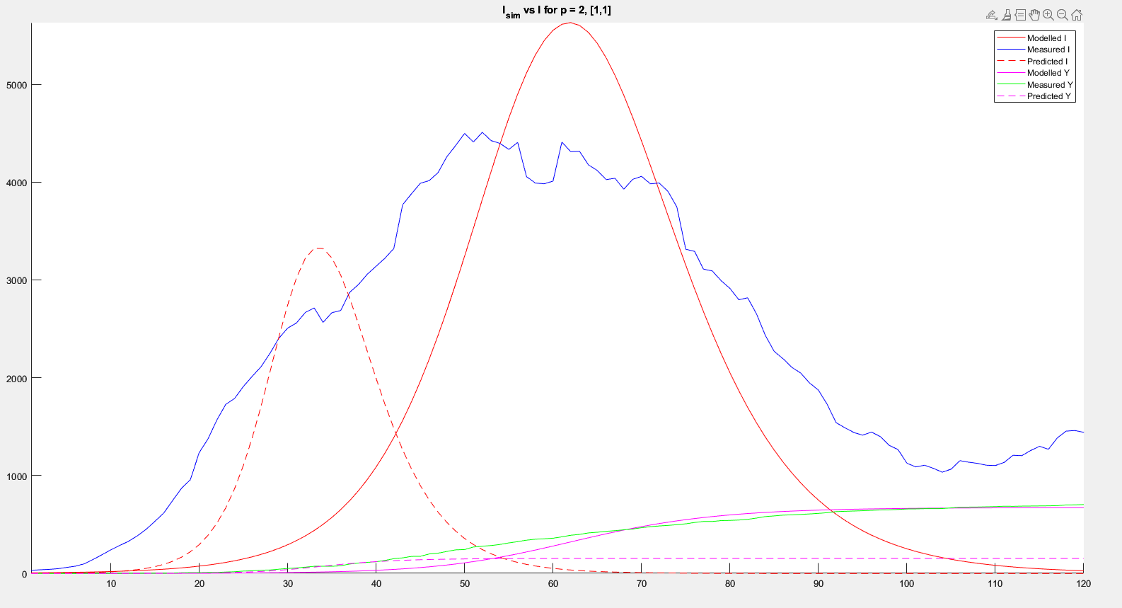
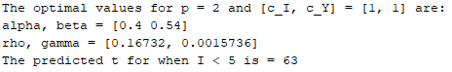
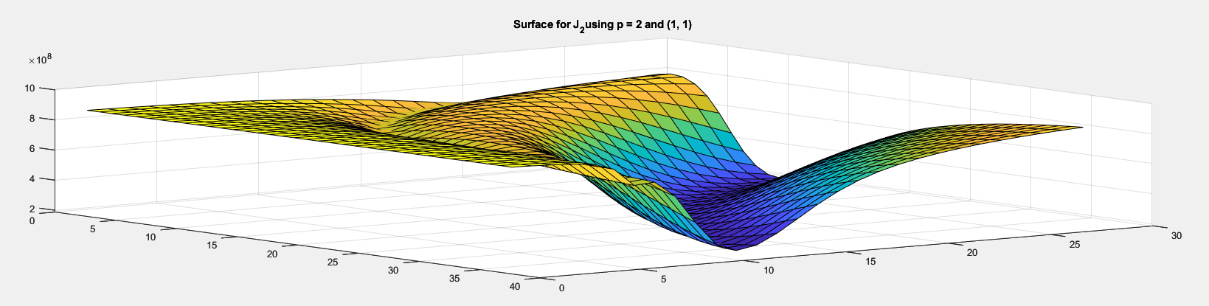
SIR Results (p = 2)
Optimal J value: 187335583.33
[c_{I}, c_{Y}] = [1, 1]
α – 0.4
β – 0.54
R₀ – 0.74
ρ – 0.16732
γ – 0.0015736 (!)

Slide 11
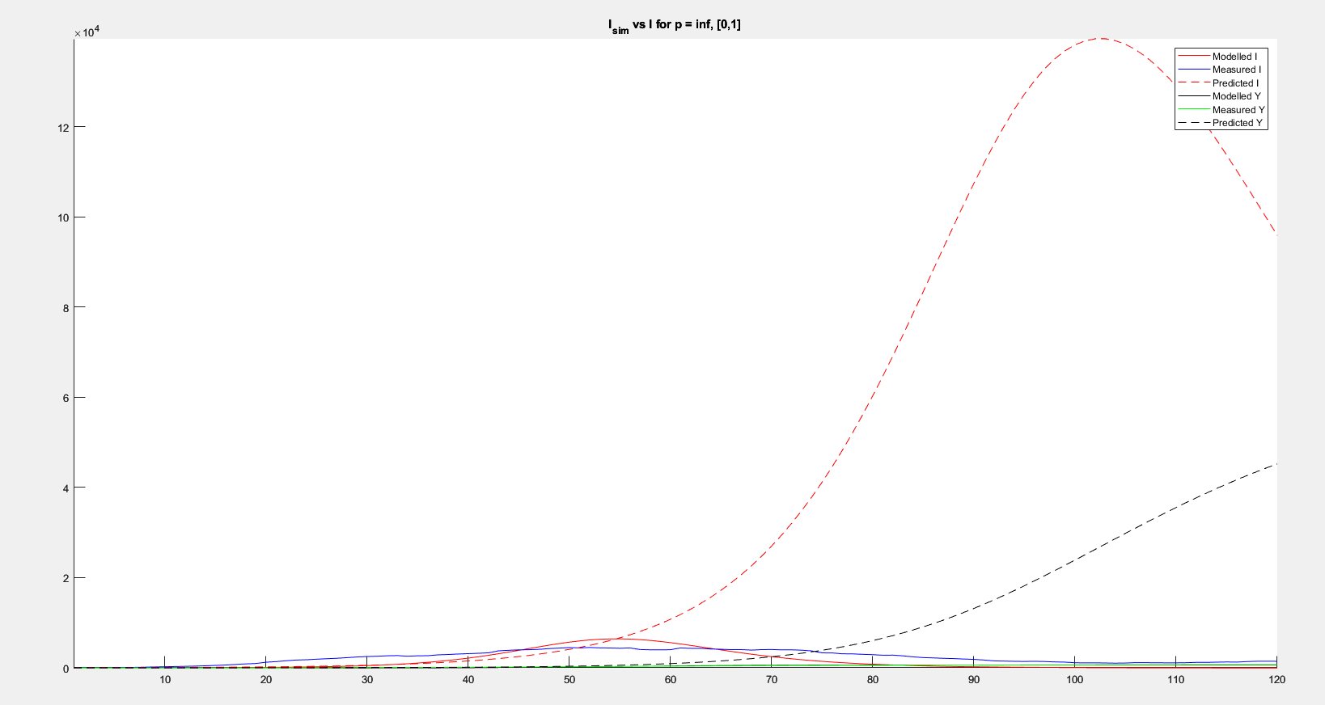
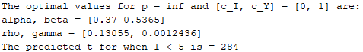
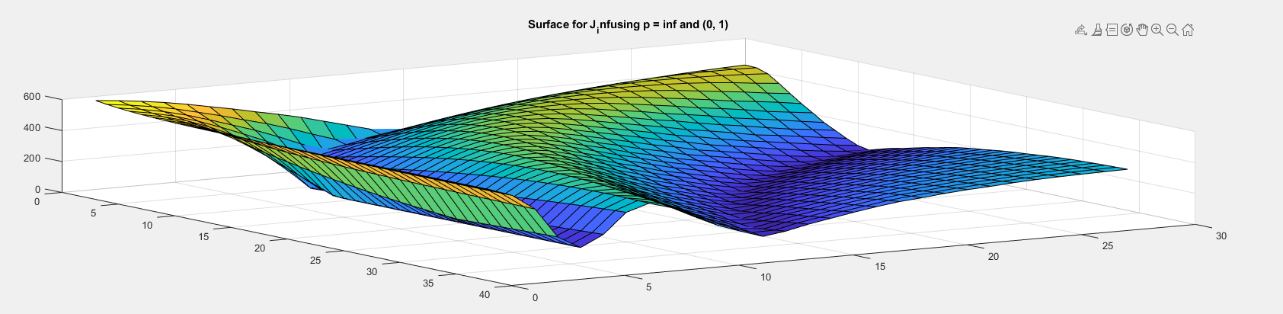
SIR Results (p = ∞)
Optimal J value: 83.202 (!)
[c_{I}, c_{Y}] = [0, 1]
α – 0.37
β – 0.5365
R₀ – 0.689
ρ – 0.13055
γ – 0.0012436

Slide 12
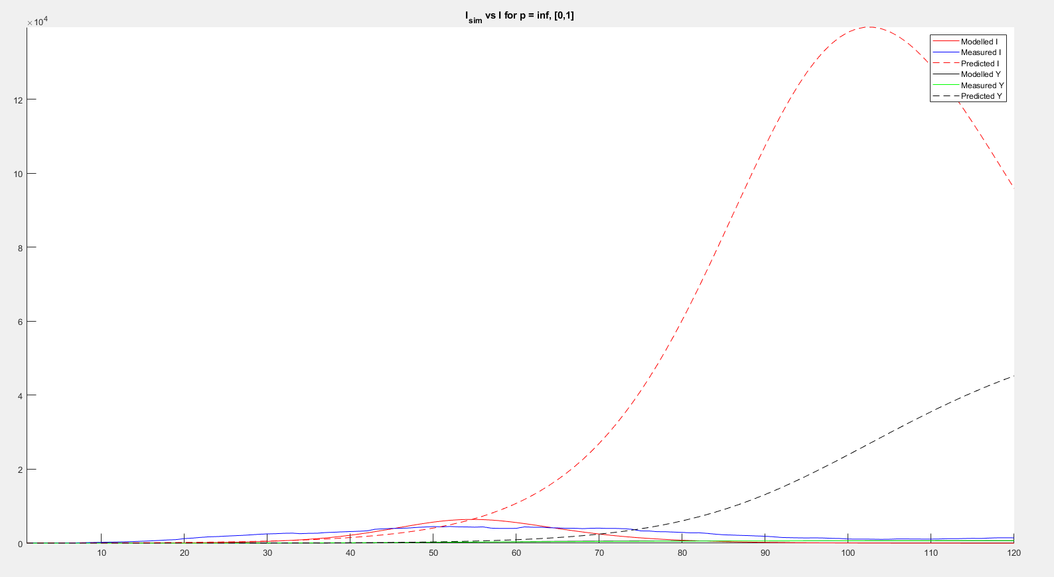
ρ_{pred} = 1
γ_{pred} = 0.0853

Slide 13
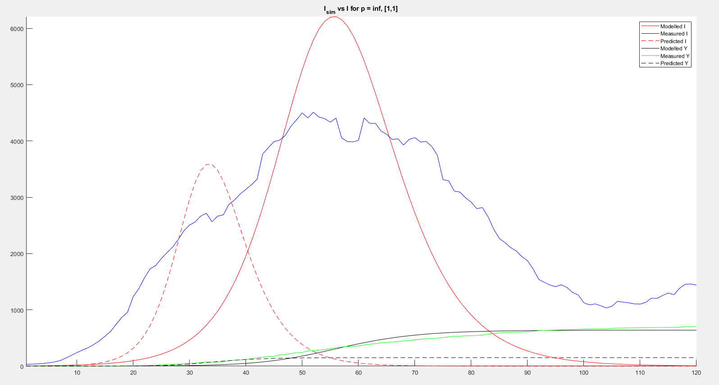
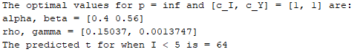
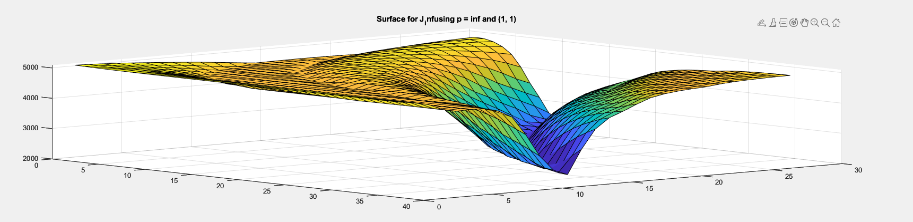
SIR Results (p = ∞)
Optimal J value: 2187.22
[c_{I}, c_{Y}] = [1, 1]
α – 0.4
β – 0.56
R₀ – 0.71
ρ – 0.15037
γ – 0.0013747

Slide 14
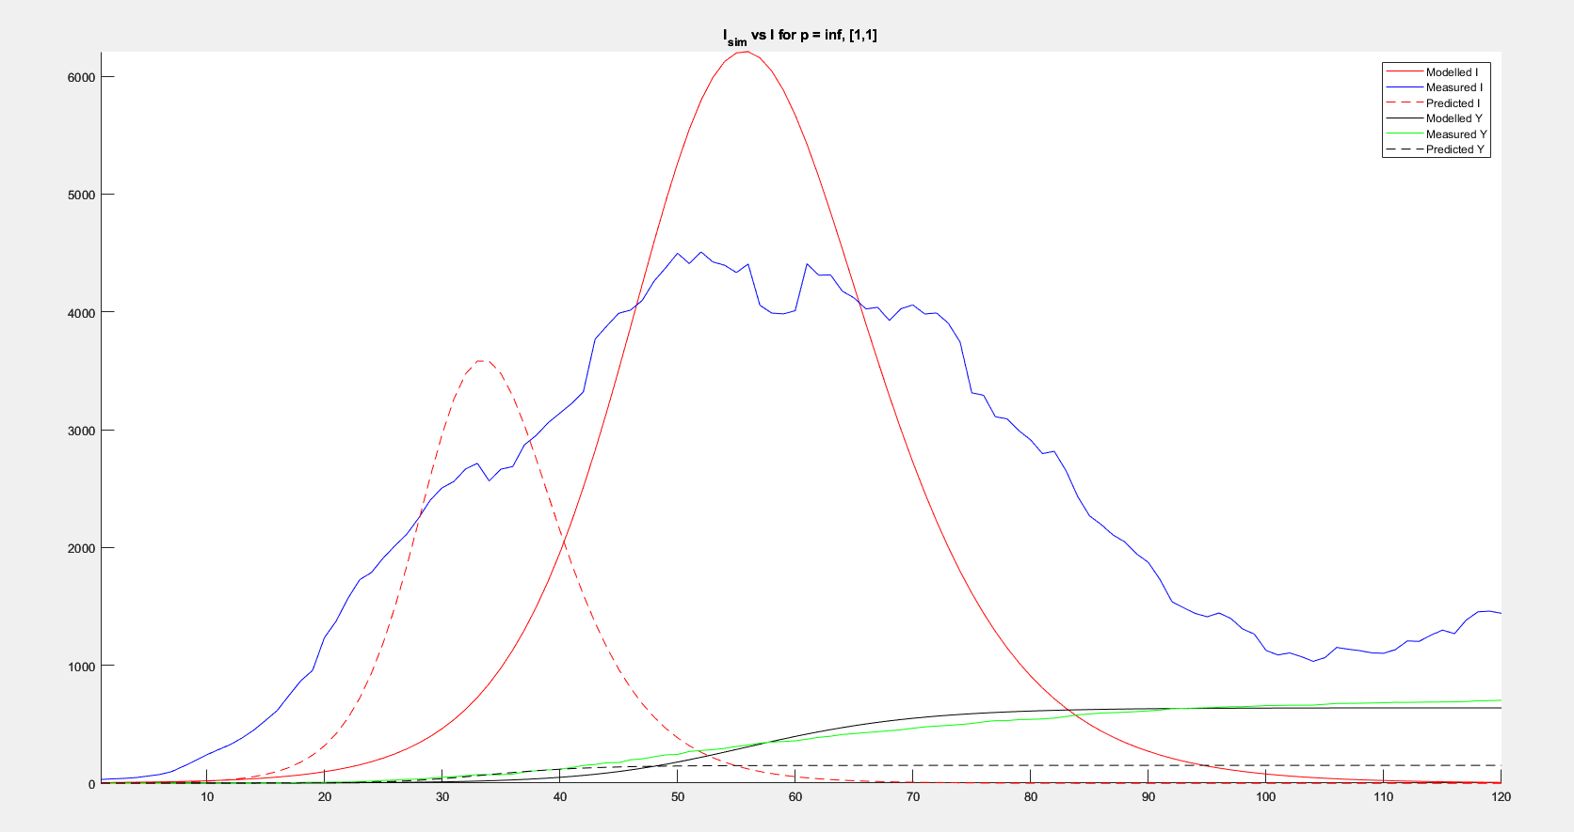

Slide 15
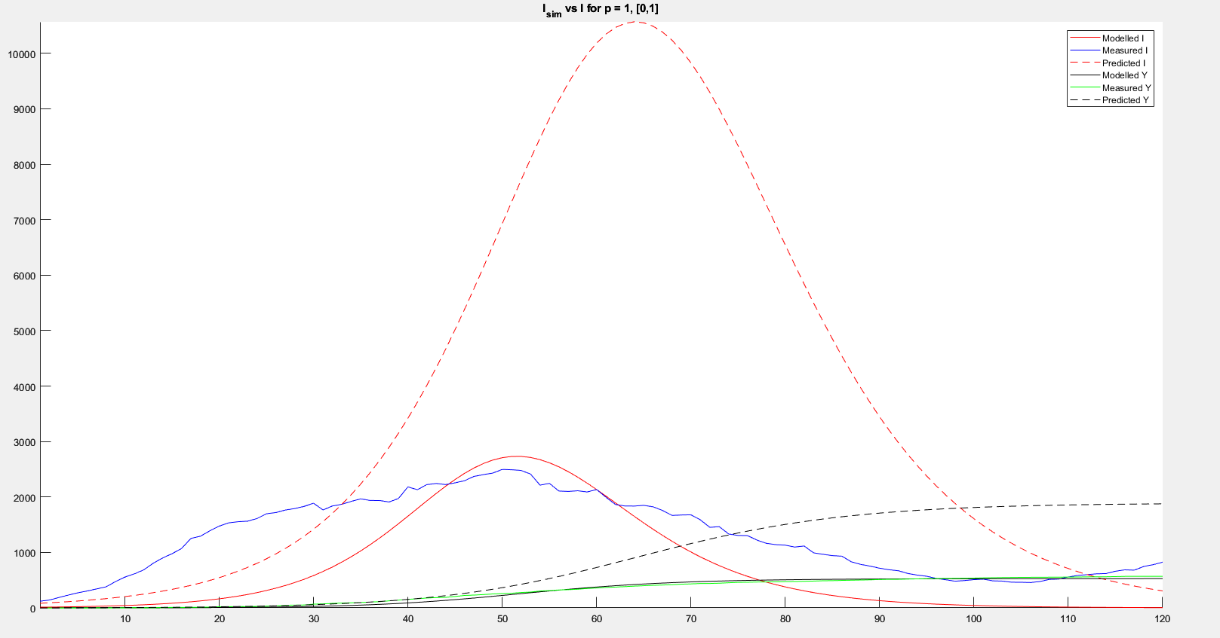
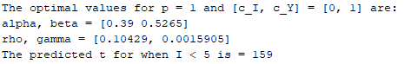
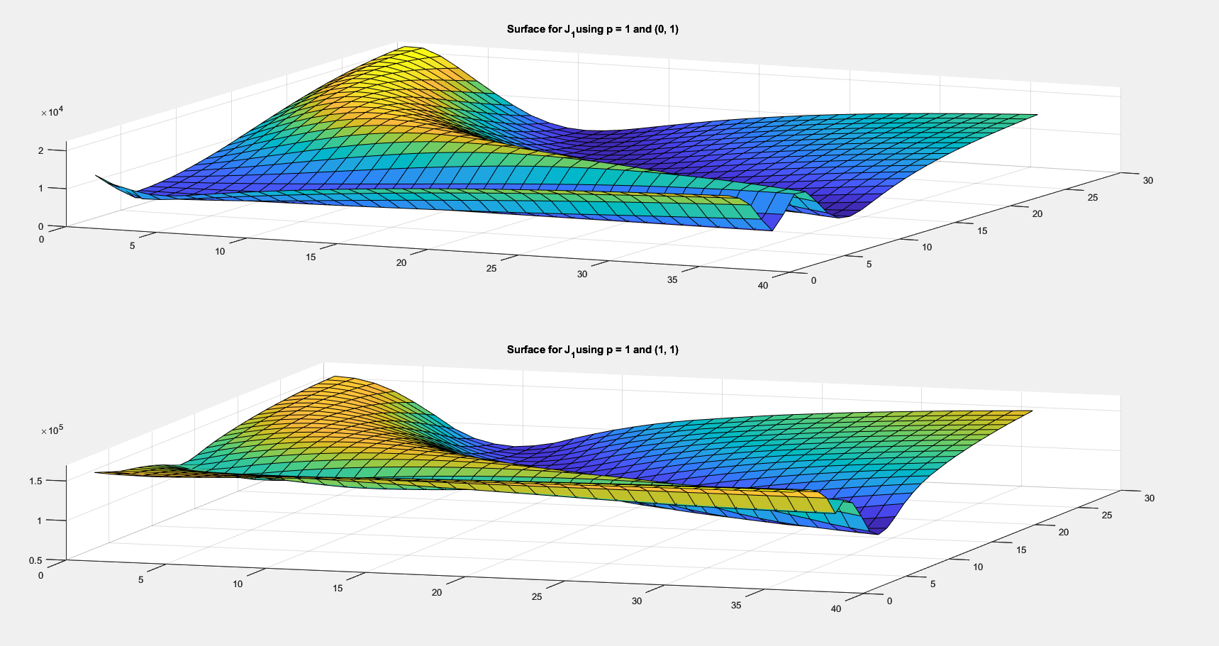
Validation Results (p = 1)
Optimal J value: 3006.96
[c_{I}, c_{Y}] = [0, 1]
α – 0.39
β – 0.5265
R₀ – 0.74
ρ – 0.1042
γ – 0.0015905

Slide 16
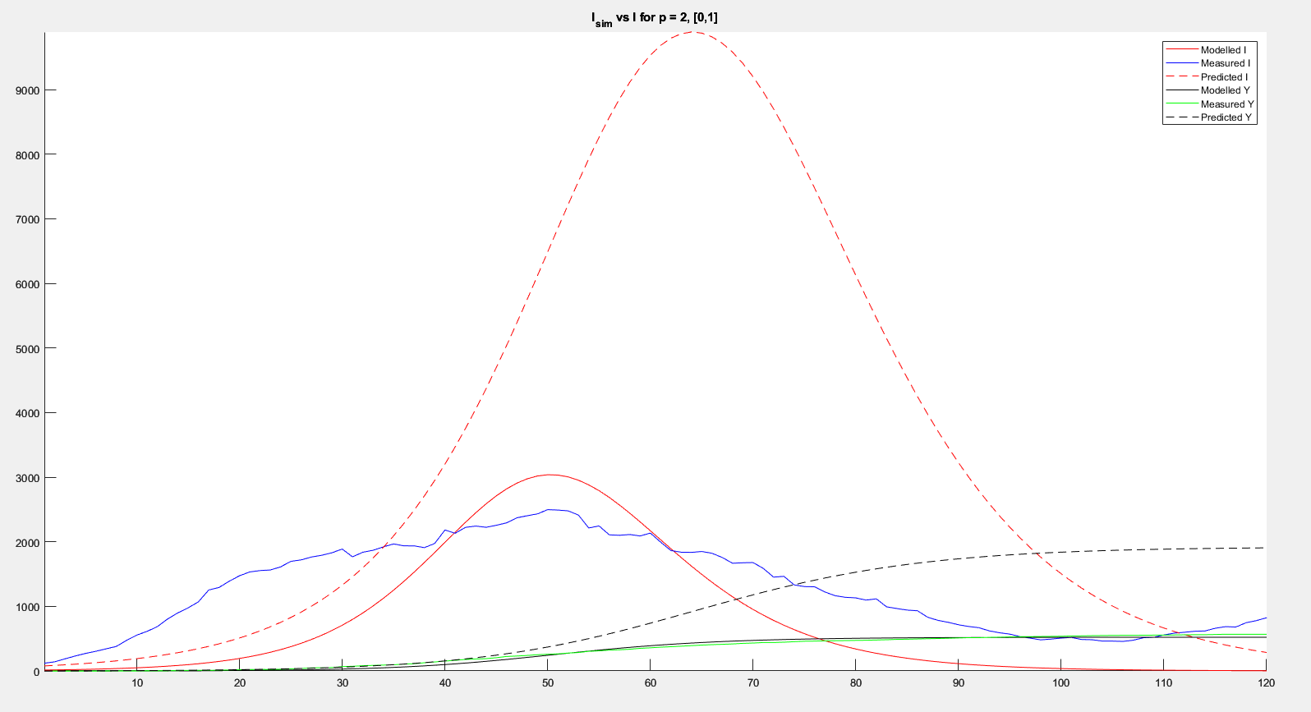
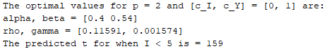
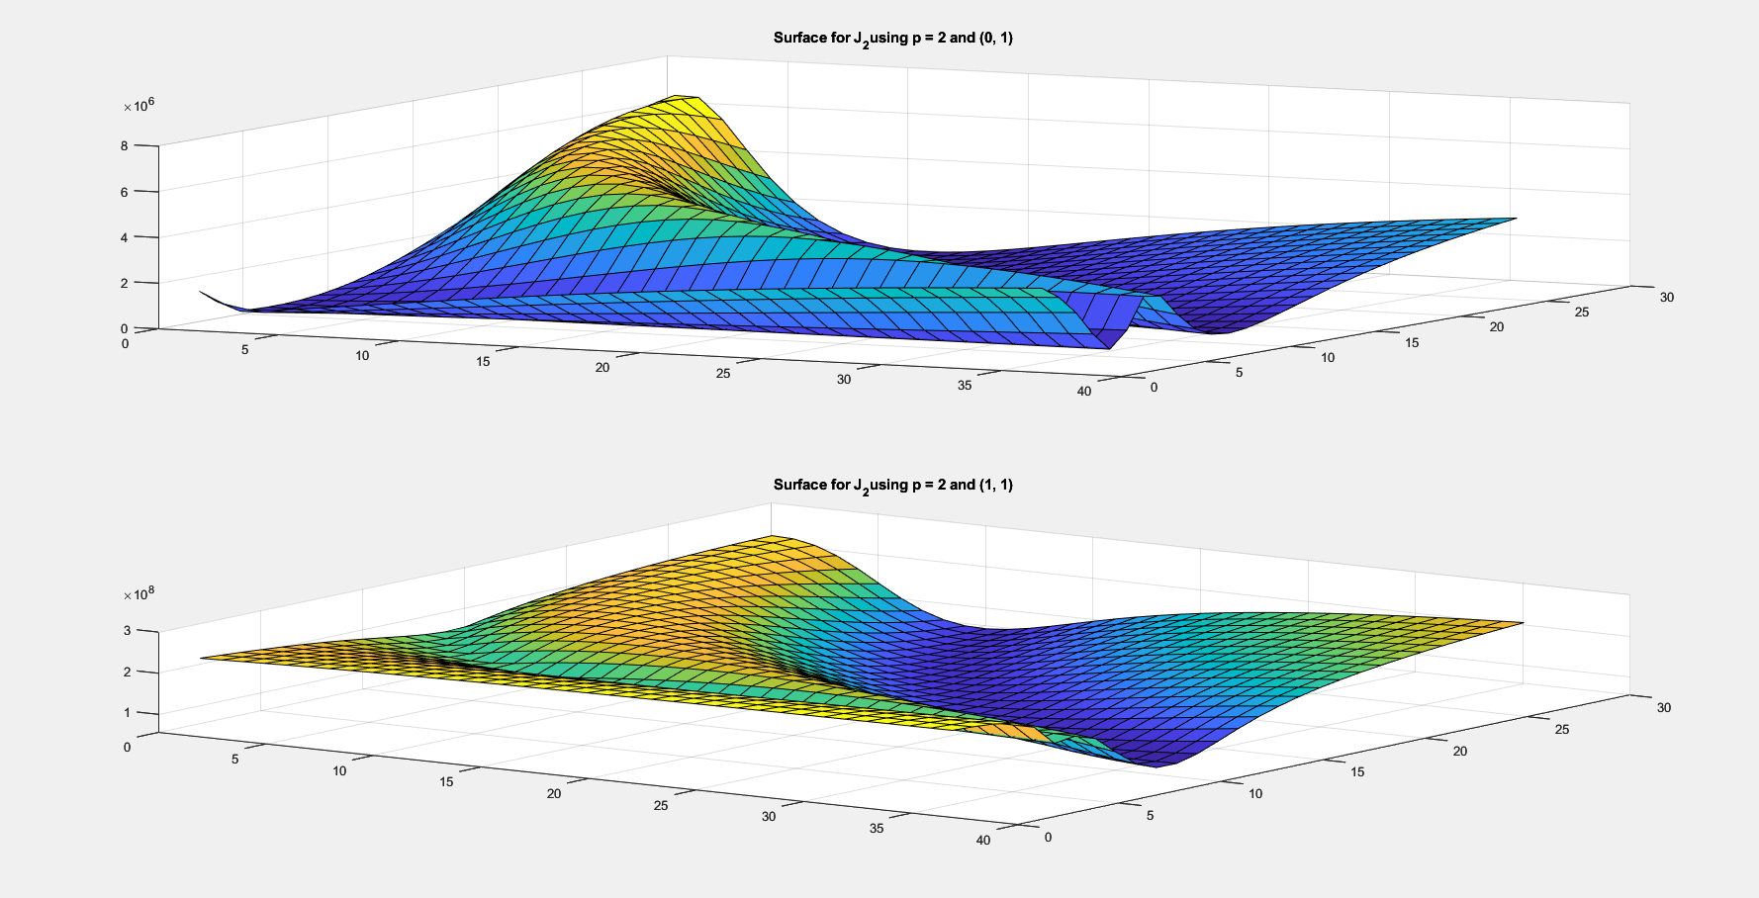
Validation Results (p = 2)
Optimal J value: 107823.59
[c_{I}, c_{Y}] = [0, 1]
α – 0.4
β – 0.54
R₀ – 0.74
ρ – 0.11591
γ – 0.001574

Slide 17
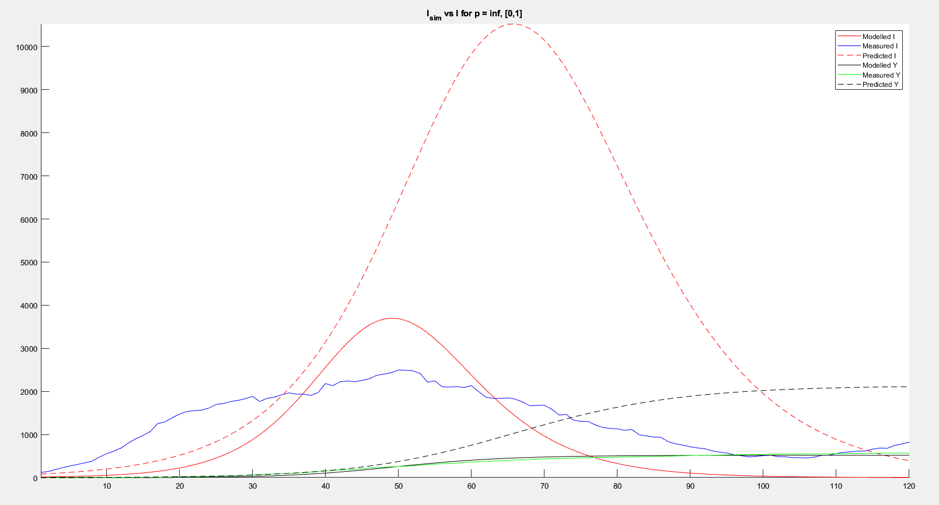
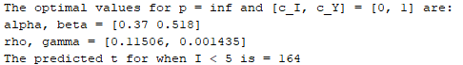
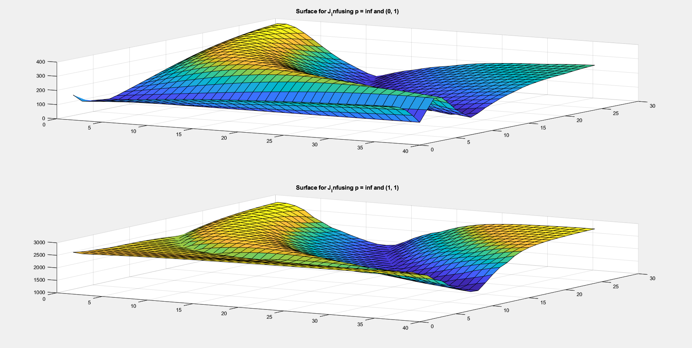
Validation Results (p = ∞)
Optimal J value: 50.03 (!)
[c_{I}, c_{Y}] = [0, 1]
α – 0.37
β – 0.518
R₀ – 0.71
ρ – 0.11506
γ – 0.001435

Slide 18
Important Points
Relatively low mortality rate (γ)
Always around 0.0013
About double COVID-19’s measured mortality rate
Similar α, β, and R₀ values as well.
Important days:
t = 55: March 17th, around when lockdown begins; UMD closes soon.
t = 70: April 1st, lockdown in full swing.
t = 100: May 1st, suspicion begins, and people start breaking lockdown.

